Slide 1

GalaMath
Sam Miller Nick Thelen Kase Tadych

Slide 2
Why GalaMath?
A fun way to study math
Nostalgic gameplay
Similar idea doesn't exist

Slide 3
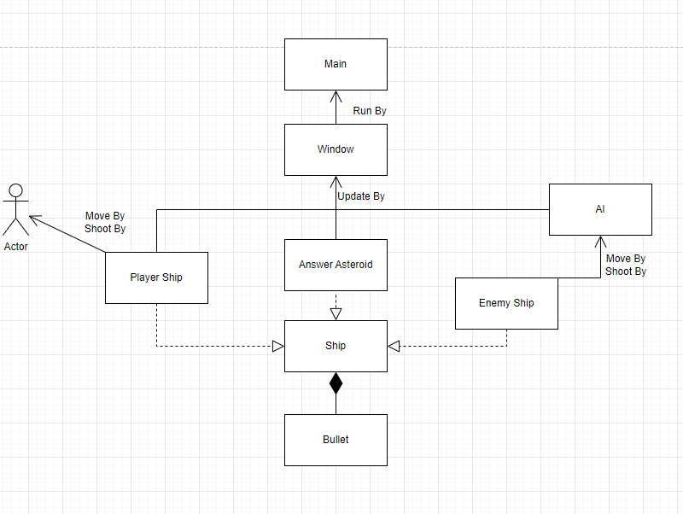
UML

Slide 4
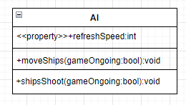

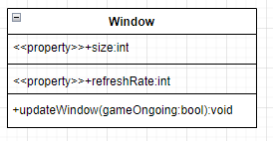
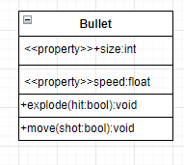
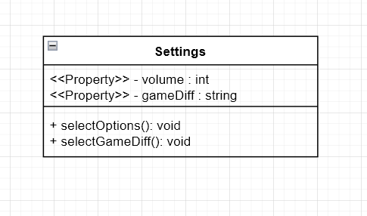

Class diagrams

Slide 5
Technologies used
Libraries
Pygame
Time
Os
Random
Software
Pycharm
Draw.io

Slide 6
Development
Version 0.1 (Pre-release):
Game Menu's
Volume and Difficulty
Playable character
Enemy characters
Version 1.0 (Full-release):
High score tracking
Additional/variations of enemies
Math questions

Slide 7
Challenges
Enemy ship double shot
Using Git Lab
Coordination with team

Slide 8
Implementation of Class Concepts
Using the SDLC when completing our project
Using OOD principles when planning our development
Polymorphism on similarly behaving objects
Version control using Gitlab

Slide 9

Q&A

